Slide 1
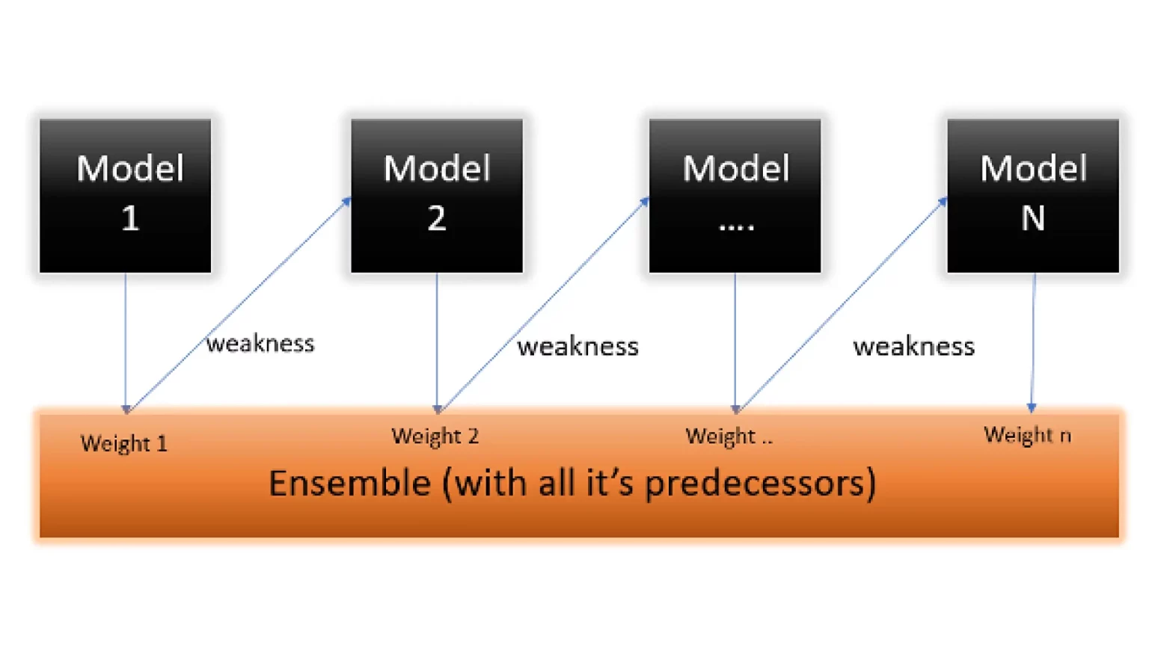
Introduction to AdaBoost
Overview of the Adaptive Boosting Algorithm
Presented by: [DEEPIKA NARENDRAN]
Date: [Friday May 2025]

Slide 2
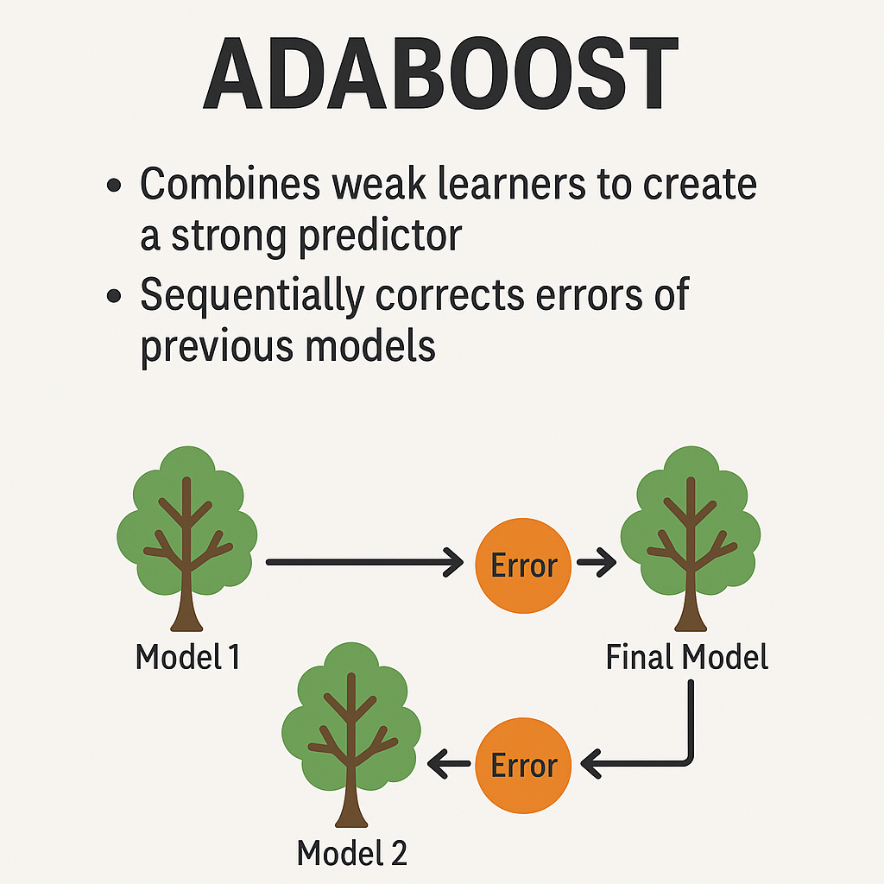
What is AdaBoost?
- AdaBoost stands for Adaptive Boosting.
- It’s an ensemble method that combines weak learners into a strong classifier.
- Introduced by Freund and Schapire in 1995.
- Commonly used with decision stumps (one-level decision trees).

Slide 3
How AdaBoost Works
1. Initialize weights for all training samples equally.
2. Train a weak learner on the data.
3. Increase weights of incorrectly classified samples.
4. Train the next learner with updated weights.
5. Repeat for a set number of iterations.
6. Final prediction is a weighted vote of all weak learners.

Slide 4
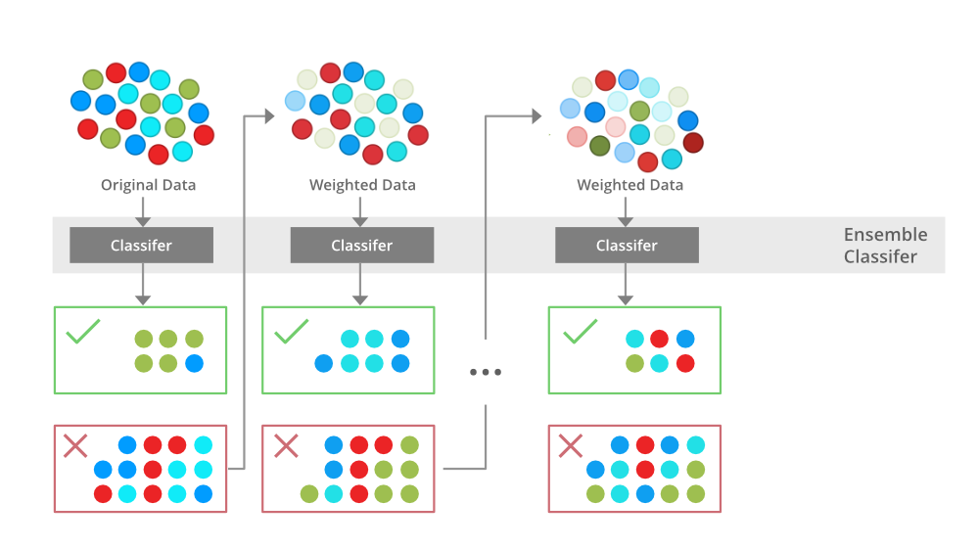
How AdaBoost Works
1. Initialize weights for all training samples equally.
2. Train a weak learner on the data.
3. Increase weights of incorrectly classified samples.
4. Train the next learner with updated weights.
5. Repeat for a set number of iterations.
6. Final prediction is a weighted vote of all weak learners.

Slide 5
Advantages and Limitations
Advantages:
- Simple and effective.
- Often more accurate than individual models.
- Works well with low-bias classifiers (e.g., decision stumps).
Limitations:
- Sensitive to noisy data and outliers.
- May overfit if too many iterations are used.

Slide 6
Real-World Use Cases
- Face detection in computer vision (Viola-Jones algorithm).
- Text classification and spam filtering.
- Risk prediction in finance and insurance.
- Medical diagnosis support systems.

